Slide 1
Starbucks drink’s
visualization for the nutrition of drink item’s

Slide 2


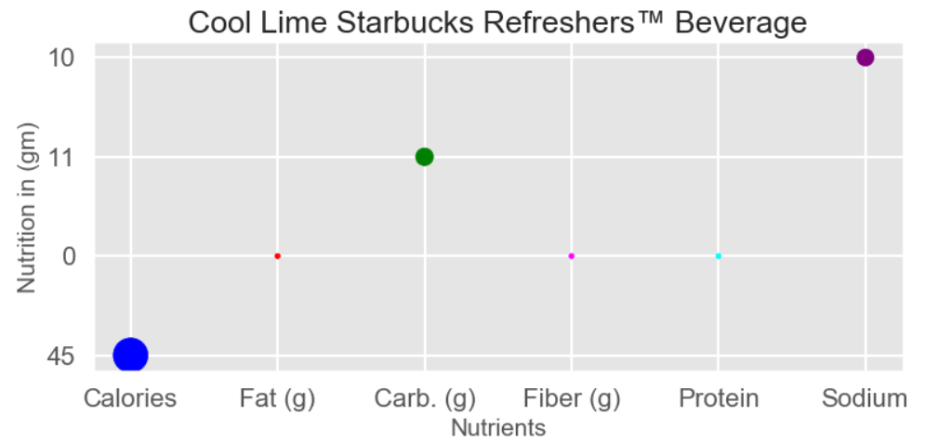

Slide 3
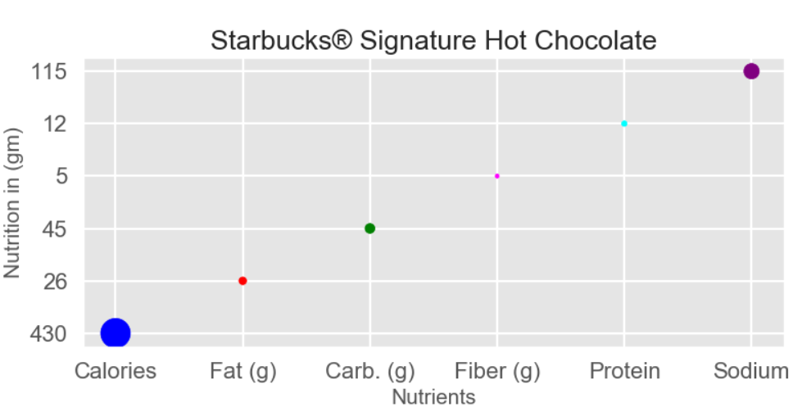

Slide 4
